Slide 1
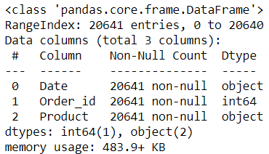
Executive summary and EDA:
We are given the transactional data of a store with Products purchased in a Order_id and Order date as Date. We are expected to identify the most popular combos and suggest best combos.
Exploratory data analysis: We perform EDA in Python and in Tableau.
We check for the missing data in Python and also look at the data types and information on the data:
The Date column is identified using an object and not as date and time. This is the same case with Tableau and we need to specify the same as to be considered as a date and time object.
There is no missing data.

Slide 2
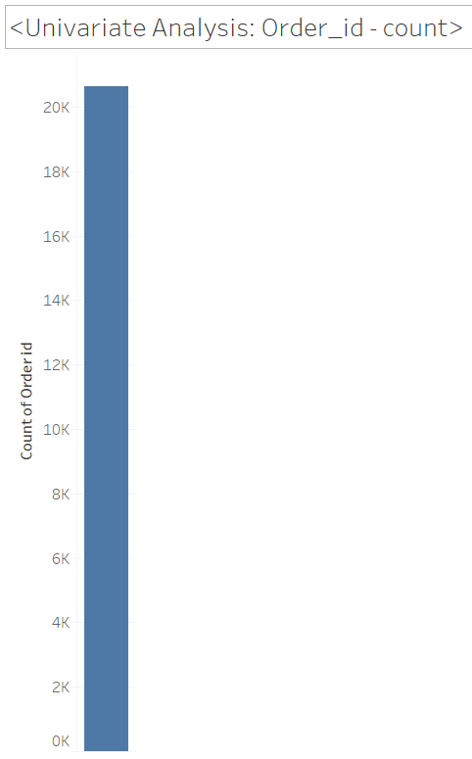
Univariate Analysis: We have a little over 20,000 list of transactions as Order_id.

Slide 3
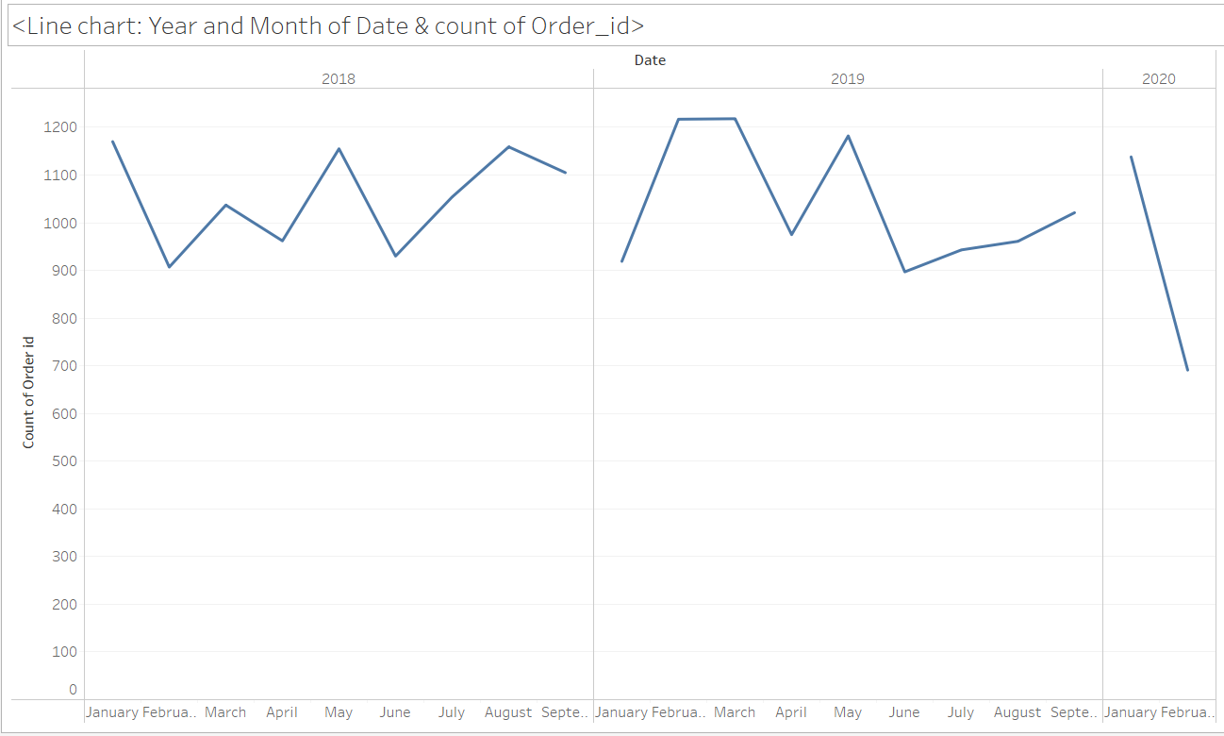
Line Chart : Year and Month of Date and count of Order_id
It can be observed that the sales (count of Order_id) increases every year between April to May and then decrease between May to June. From then the sales have again increased. It is to observe that we are given the data only between Jan – Sep of each year.
The downward sales trend between Jan and Feb of the years 2018 and 2020 is to note.

Slide 4
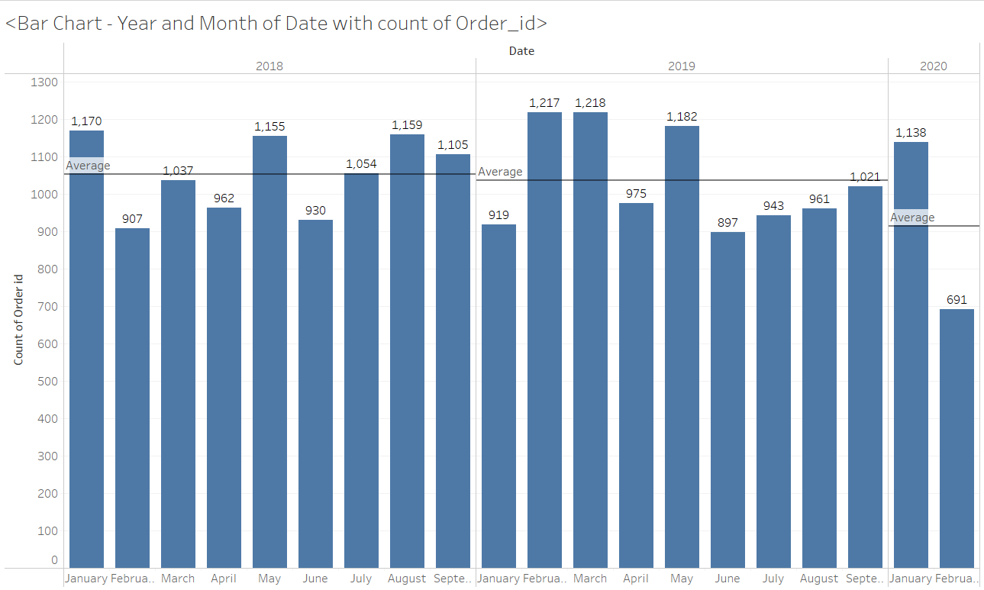
Bar Chart : Year and Month of Date with count of Order_id
It is to note that the highest number of sales ever was recorded in the months March and April of the year 2019.
The mean of the number of sales of the years 2018 and 2019 are almost the same. The average number of sales has to increase 122.5 for the year 2020 so that it can reach the previous year’s average sales count.

Slide 5
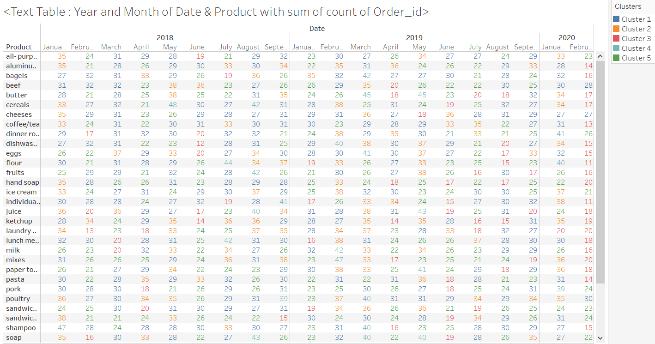
Text Table with Clusters: Year and Month of Date & Product with sum of count of Order_id
Product name: all-purpose has had the maximum sales in Jan 2018, aluminium foil has had the maximum sales in April 2019.
We also have clusters created based on the items in the order_id and they are shown in the color coding as shown.
Cluster 3 has occurred very frequently in the month of Feb 2020.
Cluster 1 and 2 have occurred 12 times in Jan 2018.
Maximum count of clusters are observed in Cluster 1 and 5.

Slide 6
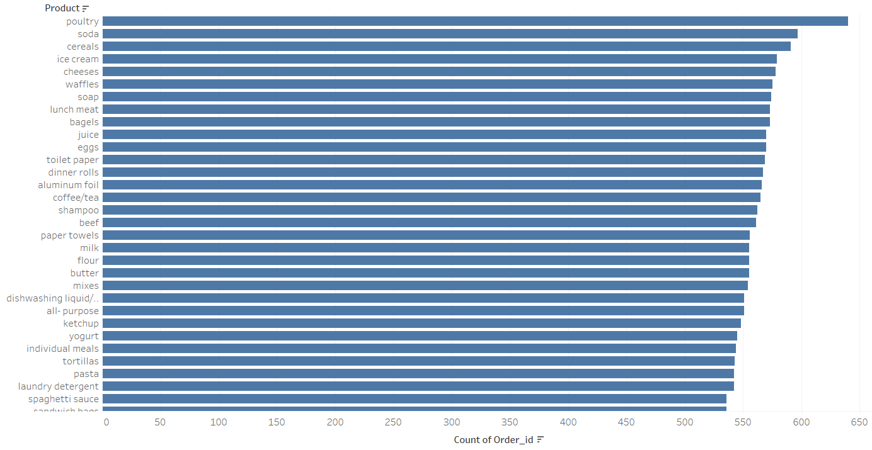
Horizontal Bar chart : Product and count of Order_id
Poultry is the most sold product followed by Soda and cereals.
The least sold product is hand soap.

Slide 7
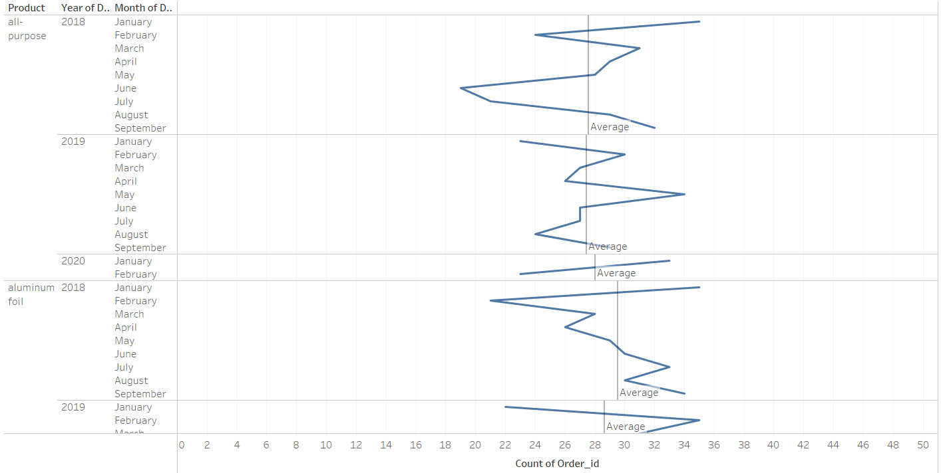
Line chart: Product sale count across year and month
The product all-purpose has seen a decline in count of sales between May and June of each year.
The product aluminium foil has seen an increase in count of sales post August each year.
The product bagels has seen a decrease in the count of sales between June and July each year.

Slide 8
For the product butter, post July and August of each year, the sale count is supposedly to rise.
Between July and August of each year, the count of cereal sales increases.
The sale count of the product cheeses has remained the same between Jan and Feb 2020.
The sale count of the product coffee/tea is to go down between Jan to Feb of each year and then rise from Feb to March. The sale count decreases from July to July of each year.
The product Dinner rolls sees a decrease in the count of sales between April and June each year and sees a rise between June and July every year.
The product eggs sees a rise in the count of sales between Feb and March each year, then declines between March and April only to see a slight rise between April and May. The maximum count of sales is done in March every year.
Sandwich bags has seen a rise in the count of sales in the first quarter of the years 2018 and 2019 but has shown to be the opposite in the year 2020.
Spaghetti Sauce sees a rise in the count of sales between Feb and March each year.
Toilet paper and tortillas have seen a drastic increase in the count of sales between April and May of each year.
The count of Yoghurt sales is highest in the month of May and then decreases drastically between May and June of each year.
The count of Waffles sales is expected to increase between the months April and May of each year.

Slide 9
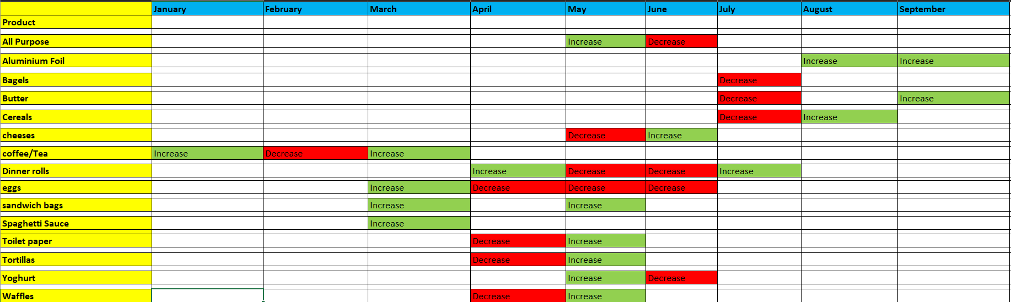

Slide 10
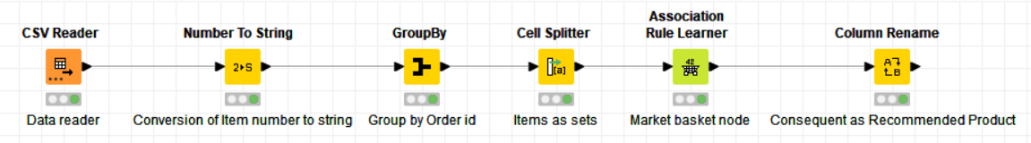
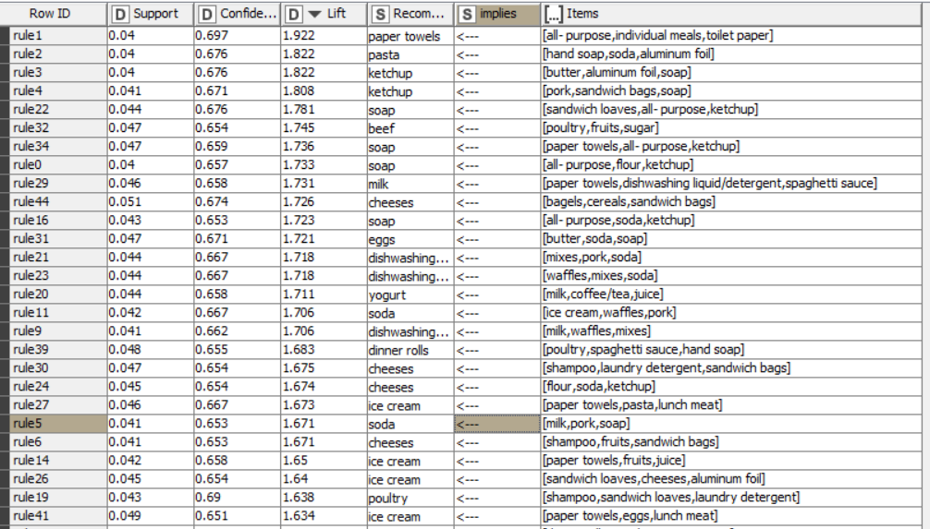
Market Basket Analysis:
We have used KNIME software to perform the Market Basket analysis on the data.

Slide 11
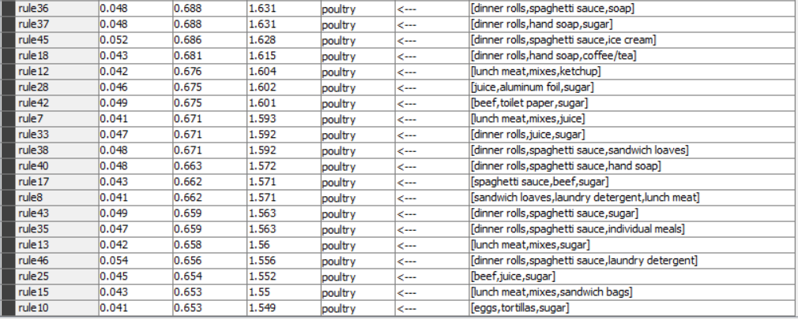

Slide 12
We have set the minimum support as 0.04 i.e. 4% and minimum confidence has been set to 0.65 in the Association rule learner node. It is to note that higher support and confidence values have been tried and it has been found that the association rule learner gives us good rules with the ones stated earlier.
The resulting rules have been organized in order of decreasing Lift.
The column Consequent has been renamed to Recommended Product name with the Column Rename node.
Each of those 47 rules is important because of the high lift and confidence values exhibited by each rule.
The Rule 1 with the highest Lift needs to interpreted as the following:
When a customer has basket items as: all-purpose, individual meals, toilet paper we recommend that the customer buys paper towels with a confident that when the customer buys the basket items he has also purchased paper towels as the confidence is 0.69 and we are sure of this recommendation as the Lift is 1.922.
It is to note that when the data is sorted on the decreasing Lift then from Rule 36 to Rule 10, the recommended product is Poultry for all the rules in the above said range.
Based on the rules 0 and 16, we can offer a combo/bundle at a discounted price for the following items: All purpose, Ketchup and Soap.
Based on rules 38, 40, 43, 35, 46, we can bundle the products: Dinner rolls and Spaghetti Sauce at a discounted price as they are commonly present among all these rules.
Poultry and meat products can be bundled at a discounted price with the cost effectiveness being shown in the quantity of each.
As a result, marketing and sales teams can develop more effective pricing, product placement, cross-sell and up-sell strategies.
MBA can be done on items and on customers. This means that grouping the customers based on their purchasing behavior. Age, Socio-economic status and number of children are important parameters based on which customers can be broadly segmented for their purchasing pattern.

